Slide 1

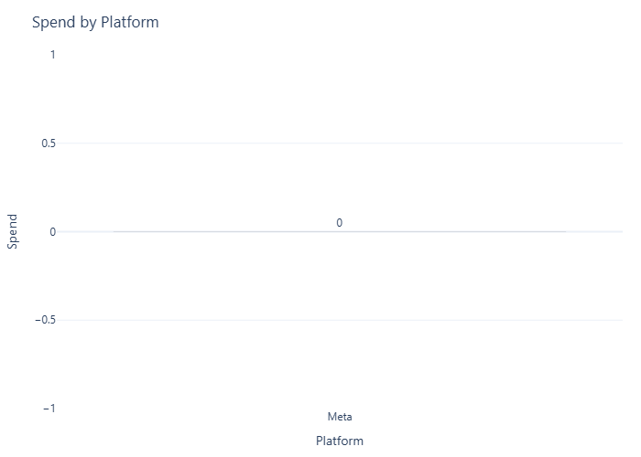
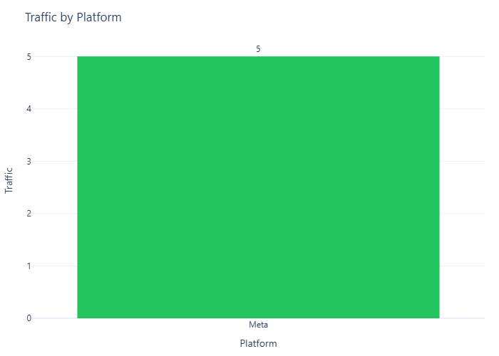
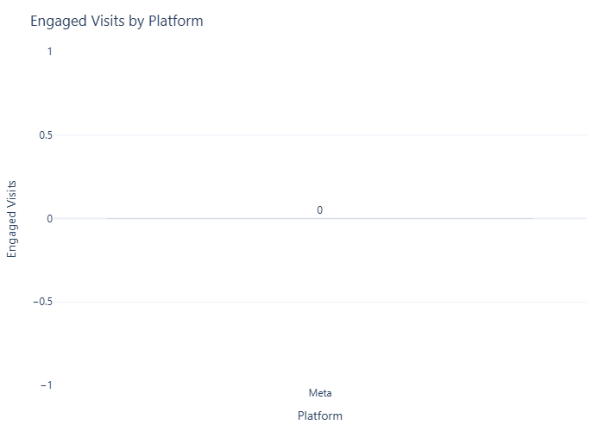
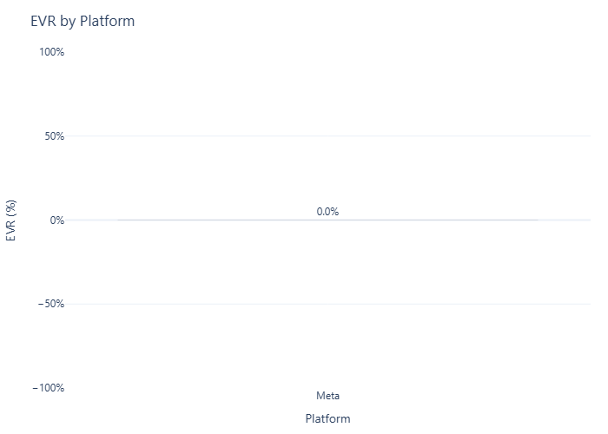
Firefly_Firefly
Contributes nan% of this campaign’s engaged visits this week.
Engagement rate is 0.0% and moved down WoW.
Highest contribution comes from **Meta**.

